Slide 1
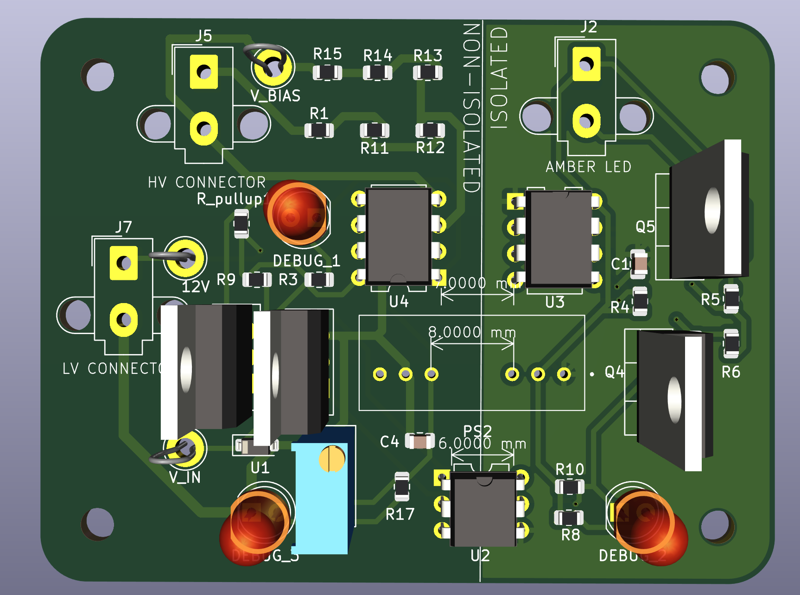
RTM Pinouts

Slide 2
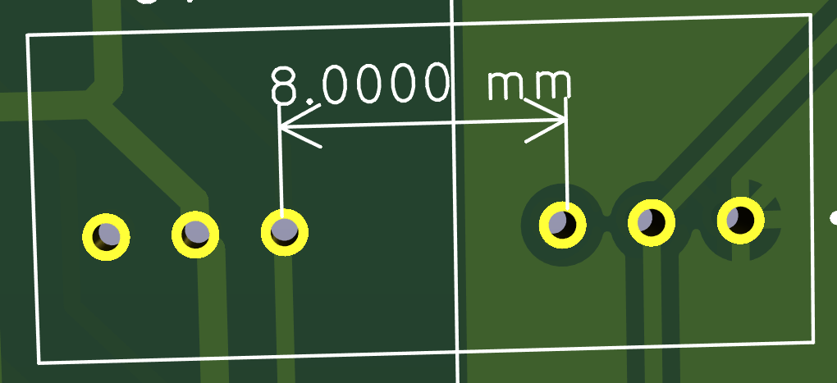
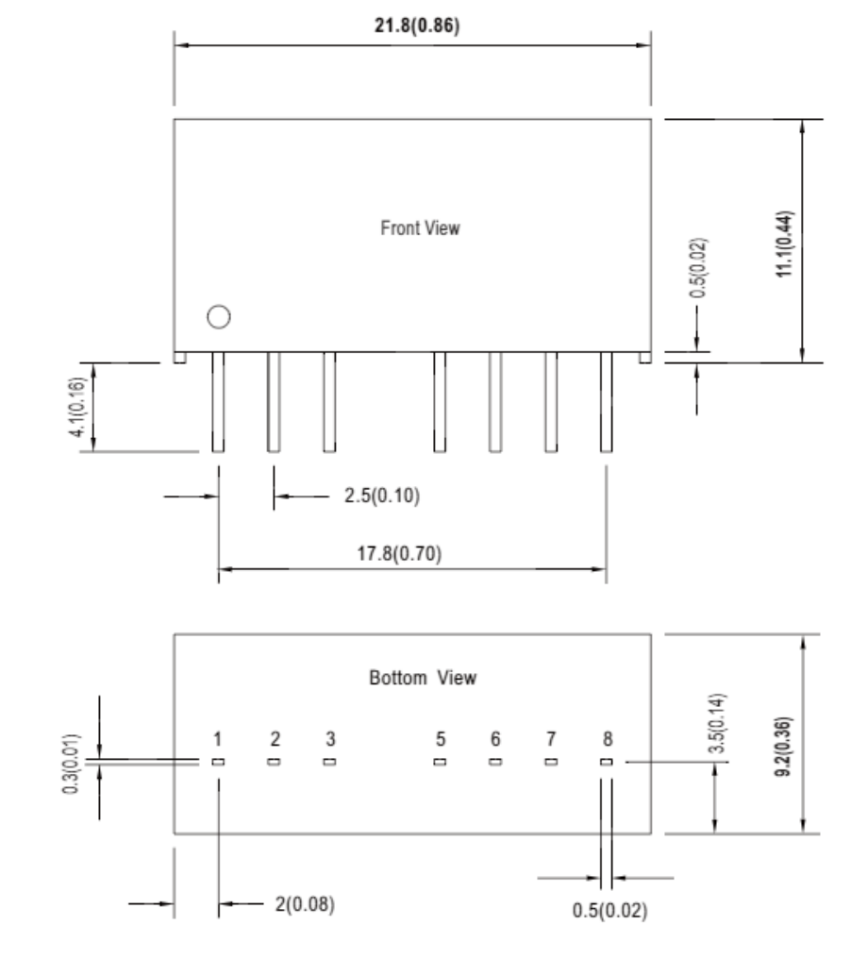
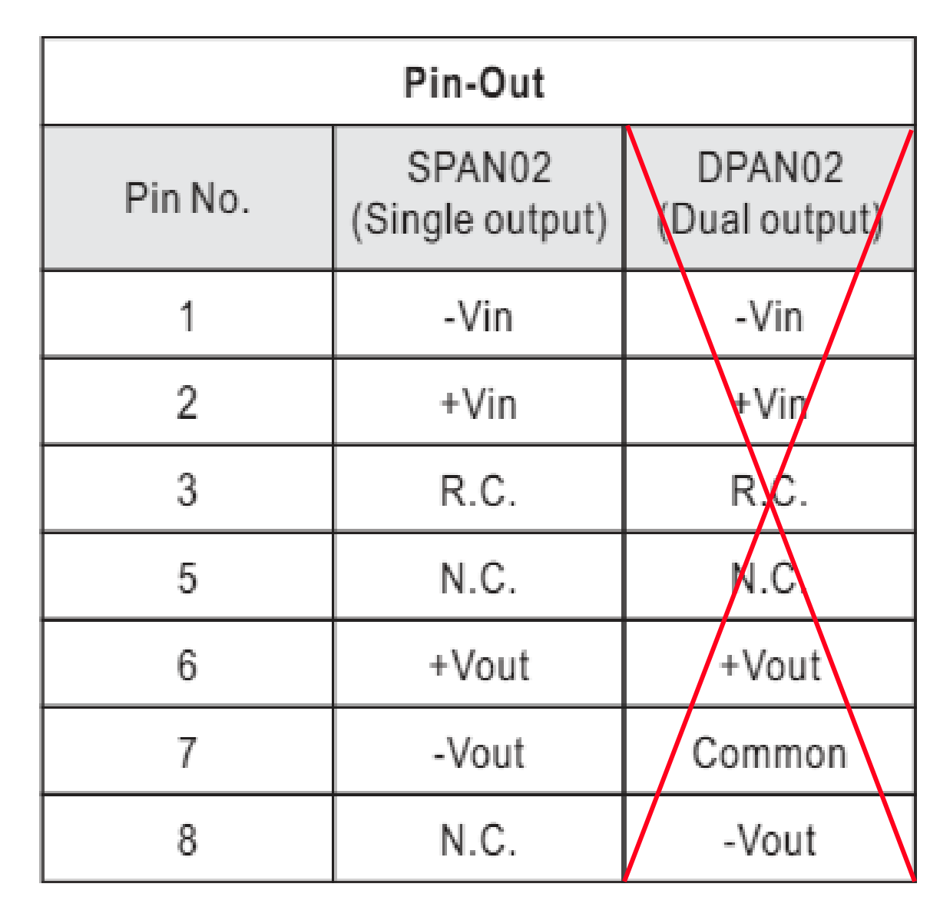
Isolated DC/DC Converters (SPAN02A-12): Datasheet
8
7
6
3
2
1
Pinouts from the Datasheet
6

Slide 3
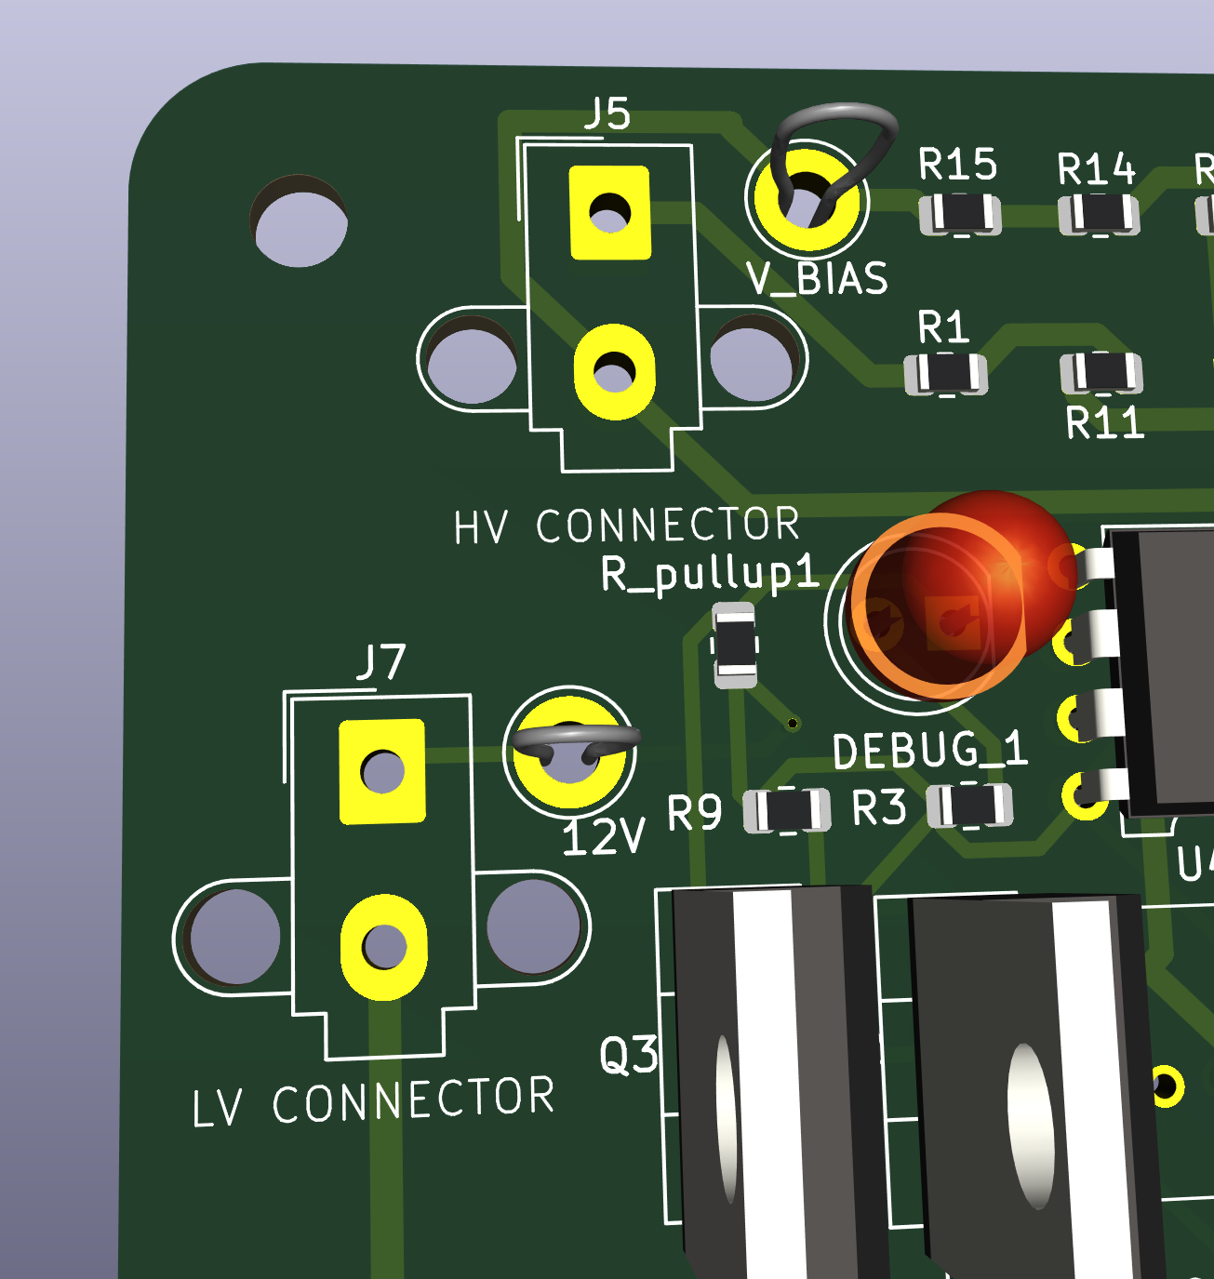
Molex Mini-Fit Jr. 2x1 (Part 1)
High Volt+
Note that 12v uniso is not used
This is on the HV side, violates
Rules, and just doesn’t let the board
Work. There is a new connector
On the other side. It can be figured out based on the side connected to the gnd plane is gnd, and the one with a wire is the +12v
High Volt-
12V UNISO
GND

Slide 4
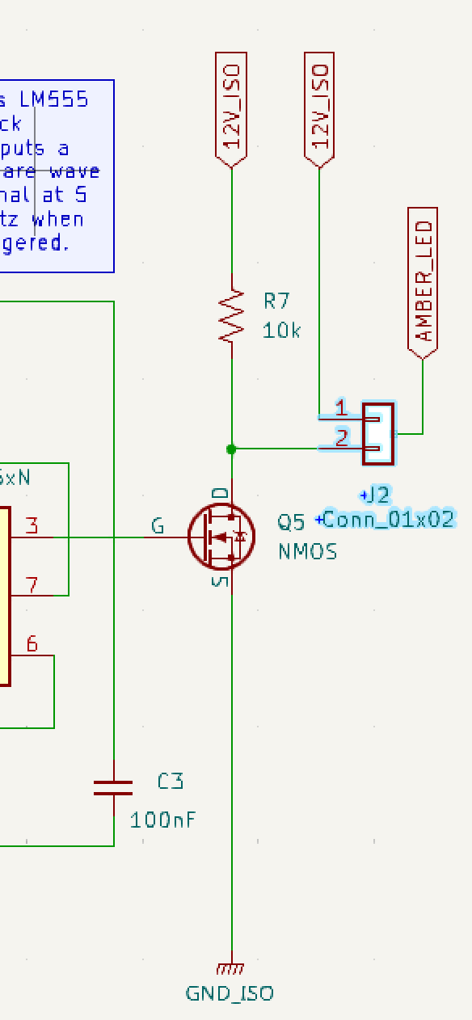
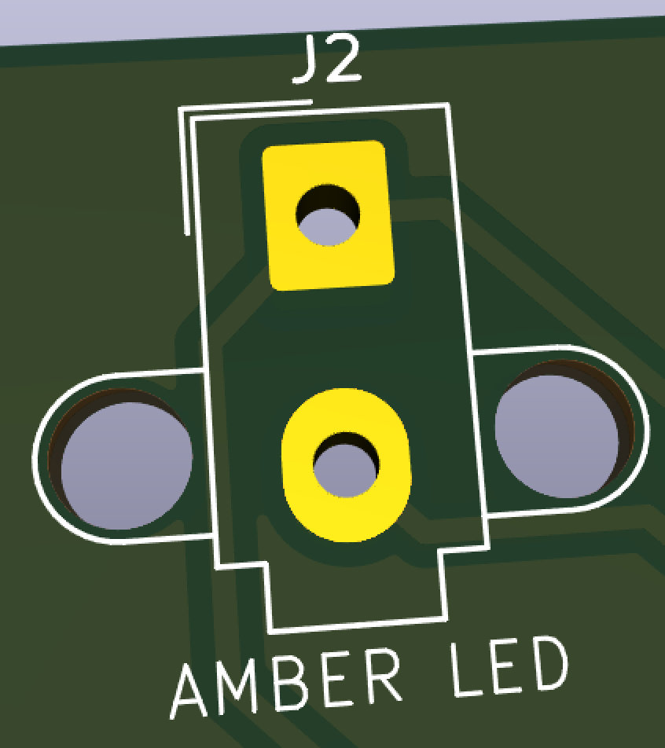
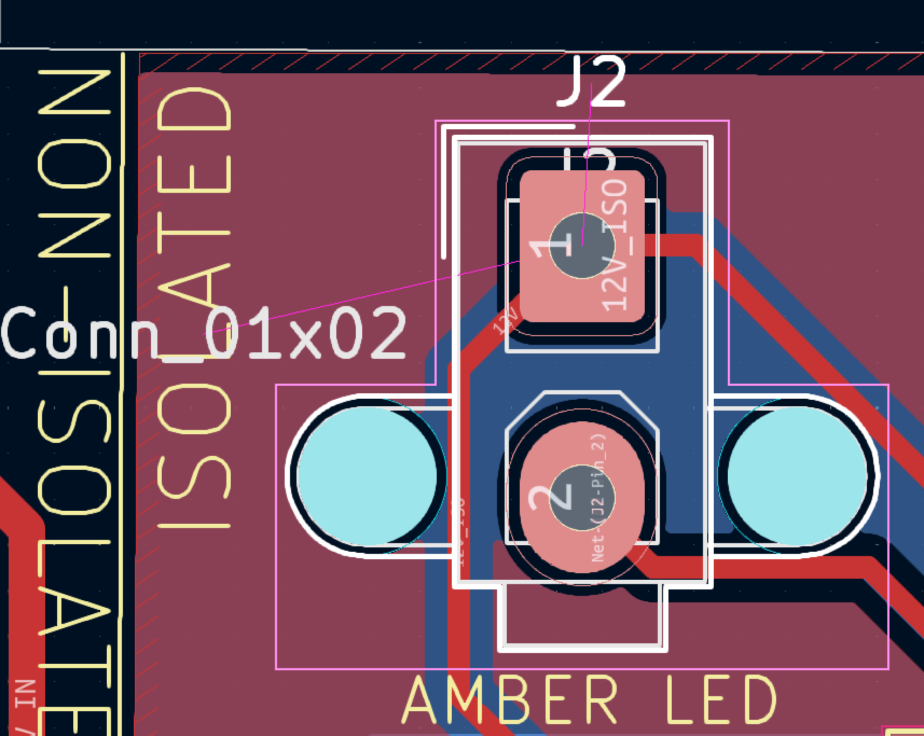
Molex Mini-Fit Jr. 2x1 (Part 2)
1
2

Slide 5
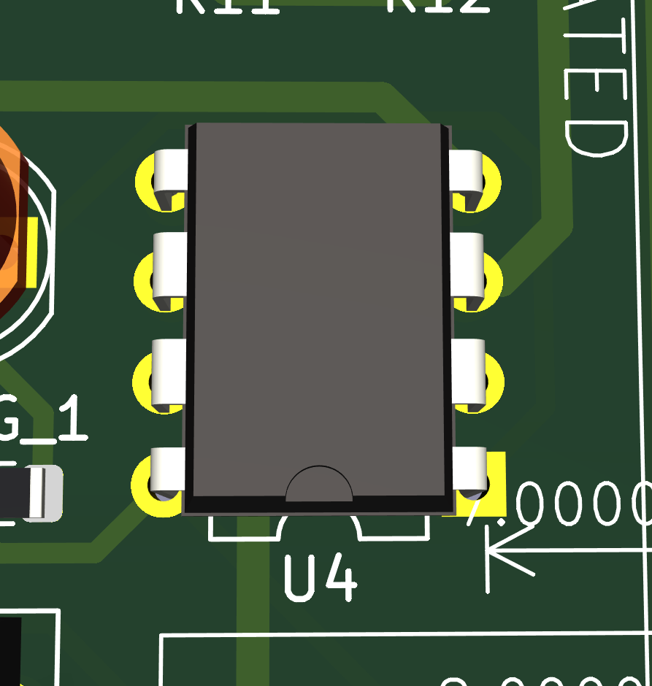
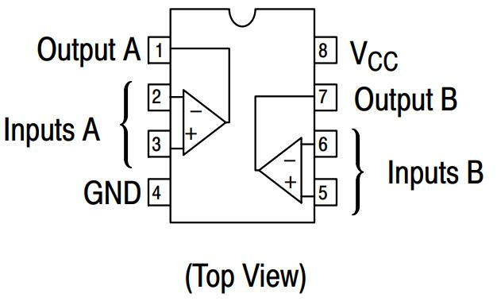
OpAmp (LM393N or NOPB), Component U4

Slide 6
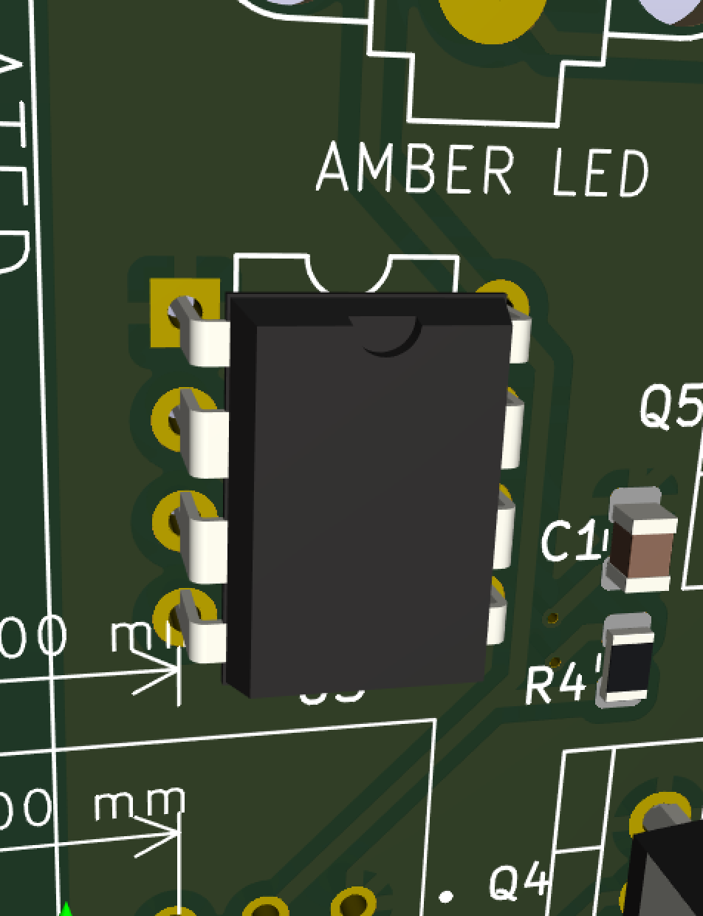
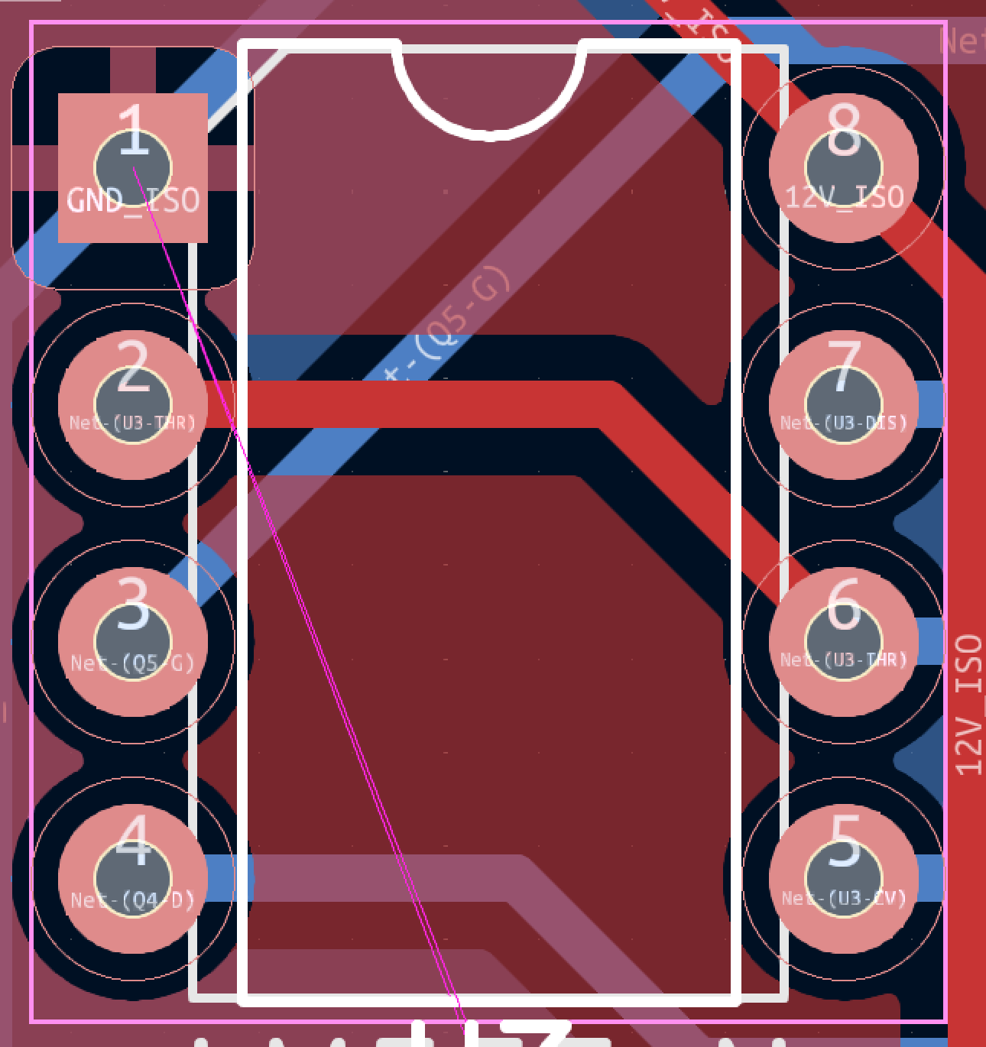
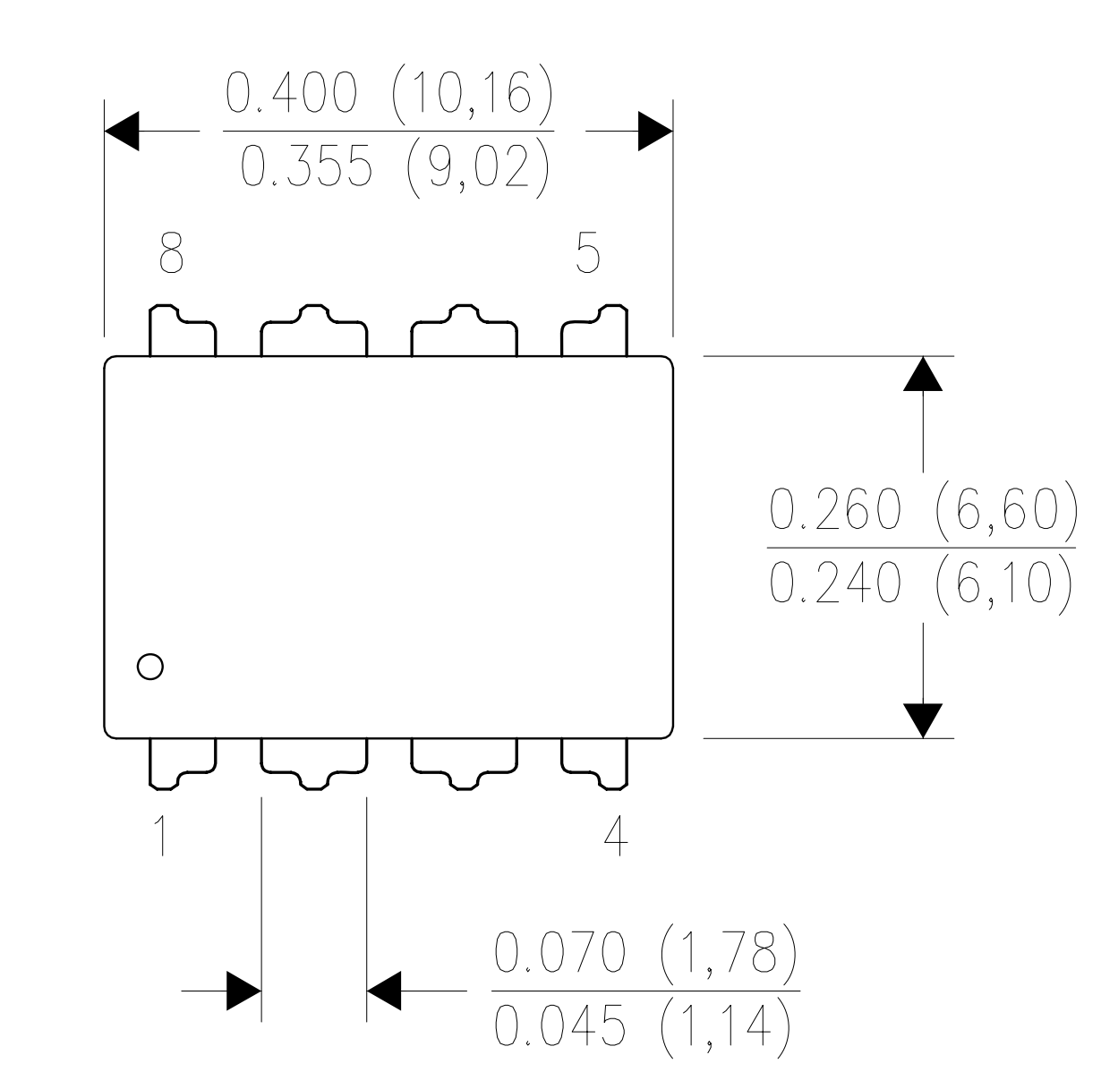
555 Timer (Component U3) Datasheet

Slide 7
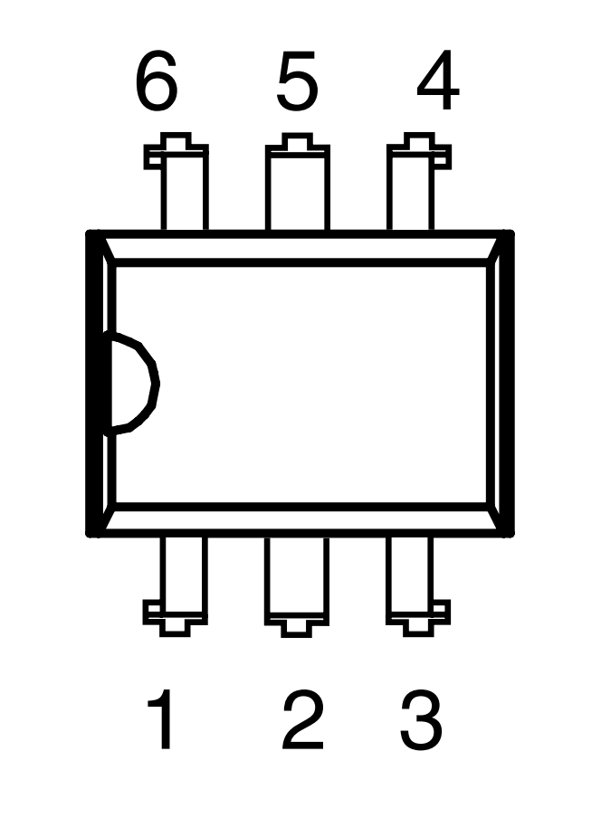
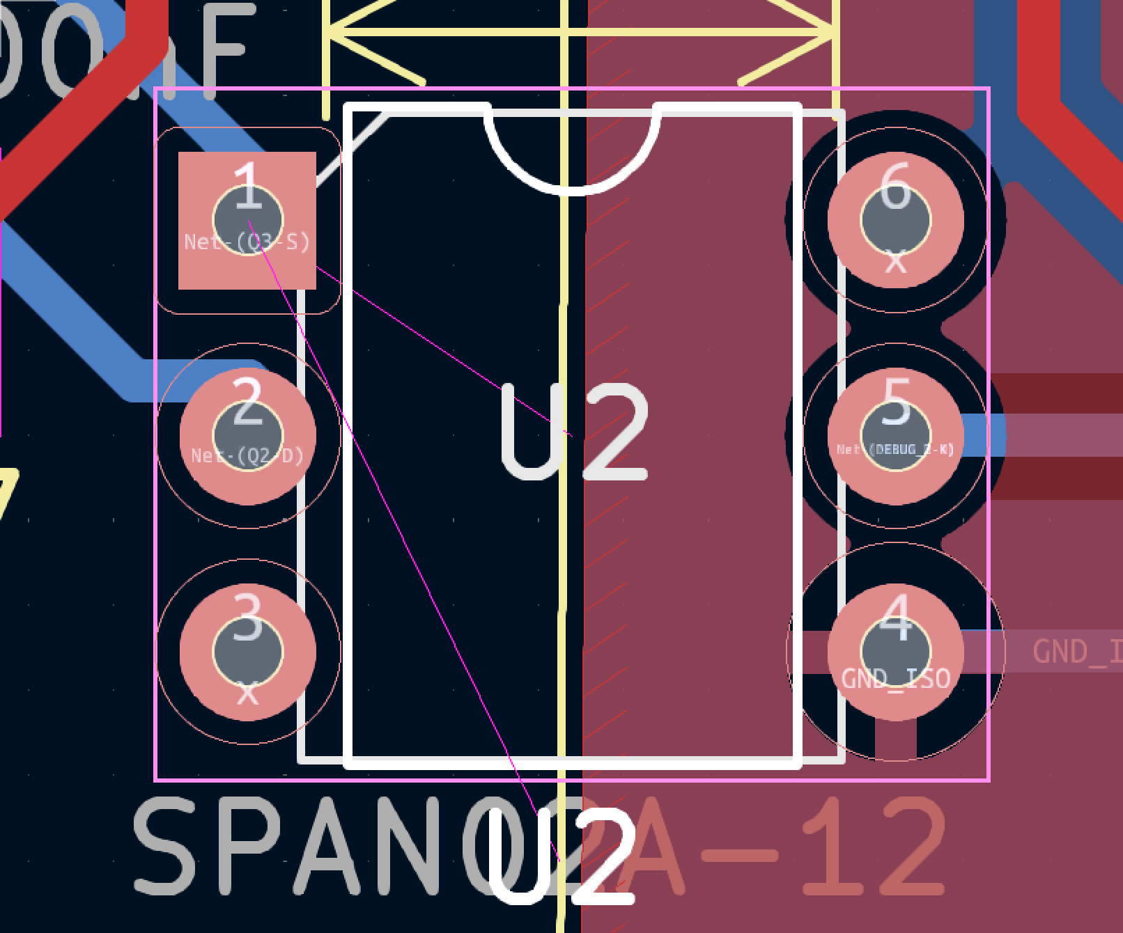
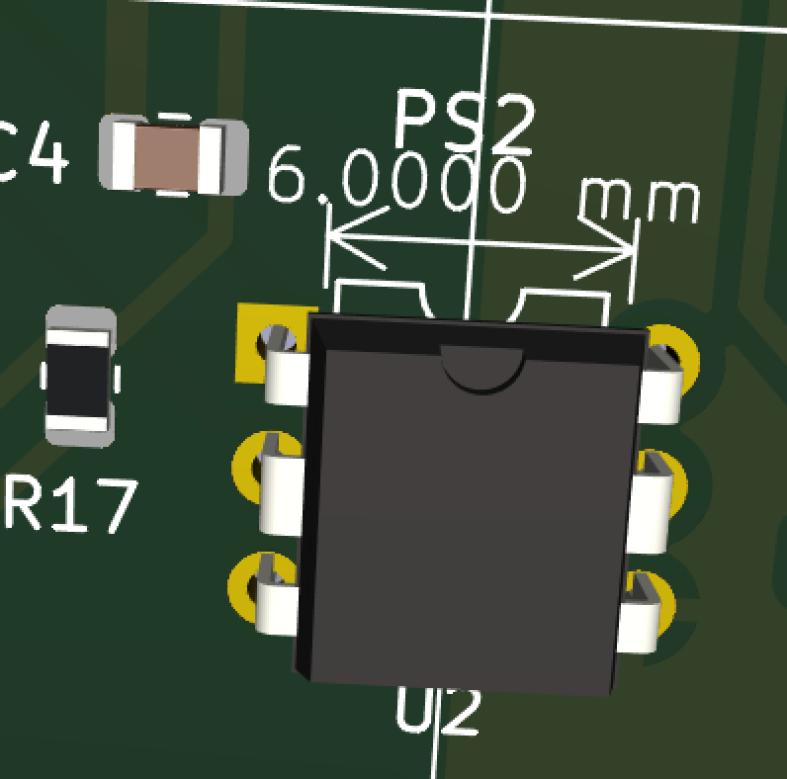
Optocoupler (Component U2) Datasheet

Slide 8
Notes:
Receive the signal to even when breaking the METHALOX records

